Slide 1
Impact of Comorbidities on ICU Utilization and Mortality in Mexico for SARS-CoV-2;
A Model to Inform on ICU Resource Utilization and Workforce Load Balancing during the Pandemic
Jody Porrazzo PhD
Anisha Parsan
Sangeetha Parsan

Slide 2
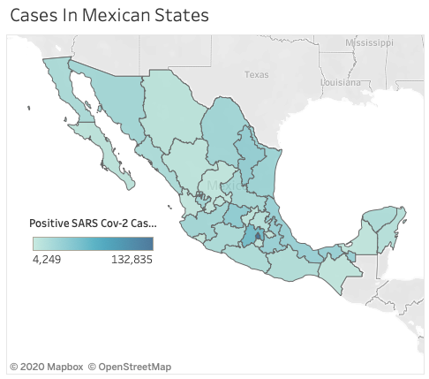
Abstract
Whilst the impact of comorbidities and age on mortality for Covid-19 is documented in Mexico, the utilization rates for ICU admission and ventilation by demographic and comorbidity is not well-known. A thorough assessment of comorbidities may help establish risk stratification of patients with this disease upon hospital admission so that hospital operations management can plan for resource and workforce load.
Our analysis looks at the probability of patient mortality based on the comorbidities and variables such as age and sex. The objective of our study is to define parameters to identify those patients at highest risk for ICU admission and intubation. Having access to this information upon admission will enable hospitals to be more agile in securing resource to treat the more severe cases of SARS-CoV-2.
Our findings indicate that the presence and number of comorbidities can be used to predict clinical outcomes of COVID-19 when patient presents for admission.

Slide 3
Statement of the problem
COVID-19 has been rapidly spreading in Mexico, straining the capacity of health care systems to respond and save lives. The number of cases, hospitalizations, ICU utilization and deaths are rising in Mexican states and municipalities. In response, healthcare organizations and communities are increasingly acting to design strategies to proactively protect inpatient resource consumption and mitigate the burden by planning resource utilization and flexing health workforce. Strategies to maximize the current health workforce include planning for complex critical care including ICU and ventilation equipment. Hospitals also are transitioning to “surge capacity” or “flex staffing” by redeploying health workers to high-need areas.
Managing hospital resource consumption and workforce load during SARS-CoV-2 pandemic is especially critical in Mexico where there is evidence that infection rates are higher for healthcare workers than in countries. In addition to the cost of inpatient treatment due to more complex care, workforce load management and availability of ICU resources must be planned for and put into place in an agile manner as seasonal impact of this disease is relatively unknown. Much of the focus has been on intensive care, acute care, and emergency department capacity of hospitals, which are all critical areas in caring for moderate and severe cases. In addition, community health care providers—primary care, specialty care, pharmacies, skilled nursing facilities, mental health, and many others—are essential during this pandemic. To maintain health care service levels for the more complex inpatient cases requires early identification of those at most at risk for ICU care and intubation for extended lengths of stay.
This is further complicated by the uneven healthcare delivery model in Mexico and the fact that Mexico leads in healthcare worker deaths from SARS-CoV-2. A Sept 3 report from Amnesty International said that more Mexican health-care workers have died from COVID-19 (1320) than in any other country. The USA ranked second with 1077 deaths and the UK third with 677. It should be noted that interpretation of these data is difficult because of the differences in collection methods.

Slide 4
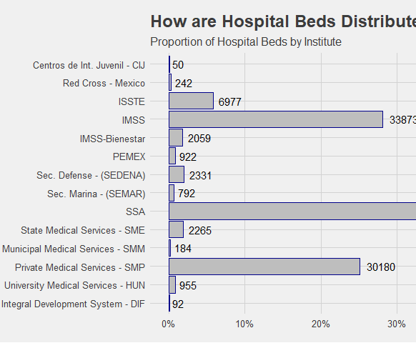
Distribution of Mexico’s hospital beds- baseline analysis
According to February 2020 data from the Secretary of Health, there are 120,240 hospital beds in operating hospitals in Mexico. Including nonoperating hospitals, hospital beds in other types of establishments (external consultancies, general support, and social assistance) and beds utilized for other purposes, the total increases to 145,544. Either of these numbers suggest an even lower number than the one implied by the previously cited beds per capita rate of the WHO in 2015.

Slide 5
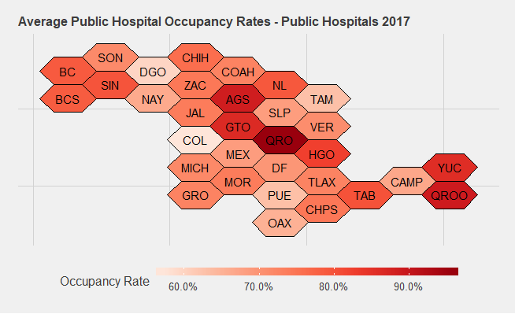
Baseline occupancy rates for public hospitals in Mexico
This article assesses how Mexico will be impacted by COVID-19 by examining hospital capacity. The author highlights the overall fragility of the Mexican health system in responding to COVID-19 and the need for measures that go beyond standard operating procedures. Many regions will be overwhelmed and face well over 100 percent occupancy rates, which will further push up the death rate as doctors have to make life and death choices on who receives care.
Media reports on overflowing hospitals in Mexico suggest that these scenarios are already a reality for some hospitals and regions but published reports also indicate that ICU utilization is only at 53%! One question is whether people are being admitted to critical care when they need to be.
https://dai-global-digital.com/examining-hospital-capacity-in-mexico.html

Slide 6
Literature overview
Several studies we saw looked at optimal utilization of resources of the public and private sectors. This analyses have important limitations. One is that they do not consider at-risk demographic and comorbidity risks. Healthcare access is not equal in Mexico is another factor which we could not evaluate. Whilst some studies do look at age factors, most did not consider factors such as obesity, respiratory conditions, and other comorbidities.
While we know these factors are important, no study yet has been able to quantify the increased likelihood of hospitalization and ICU utilization for these population subgroups as has been done with age groups and the probability of the condition rapidly deteriorating to an extent of requiring extensive support resources and equipment.
This is a primary goal of our work, whilst we recognize the under-reporting of mortality, latency and other and limitations of the data.
There are many comprehensive online tools available for data visualization of COVID outbreaks by demographic, some also providing access to the raw data. None of these tools however give user the opportunity to explore the delivery environment, source code and data.

Slide 7
Mortality in the most affected countries
For the twenty countries currently most affected by COVID-19 worldwide, the bars in the chart below show the number of deaths either per 100,000 population (this represents a country’s general population, with both confirmed cases and healthy people) or per 100 confirmed cases (observed case-fatality ratio)

Slide 8
Data and Privacy
Data set was acquired from the official website of the Government of Mexico https://www.gob.mx/salud/documentos/datos-abiertos-152127
Latest download on 09/22/2020
There is no PII (Personally Identifiable Information) present in the data, and the dataset was publicly available.

Slide 9
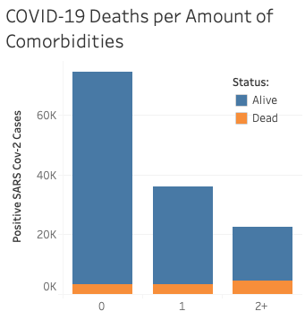
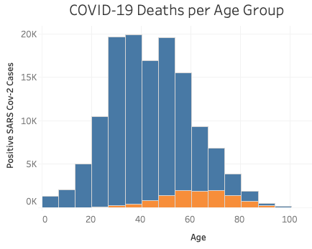
Visualization
Increase in the amount of comorbidities appeared to trend towards higher mortality
Mortality also seemed to trend towards older age groups

Slide 10
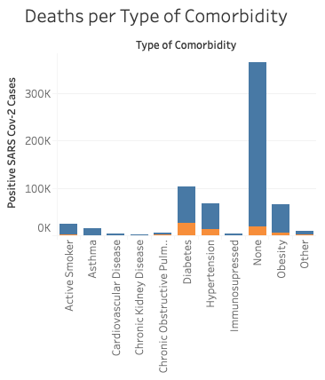

Visualization Cont.
Certain diseases and categories (such as cardiovascular diseases) tended to have higher mortality in positive SARS CoV-2 cases.
Visualizations such as these aided in determining which factors to consider in our study
Link to full mortality, comorbidity and demographics dashboard
https://tinyurl.com/dashboardmexico

Slide 11
Technology Overview

Slide 12
Technology Stack Overview
Tableau Public – Visualizing and analyzing data
R Studio and Shiny App - Build and deploy a web application
Google Colab - Iteratively programming
Lucid Chart - Modeling data flows and transformations
Working with an extensive and rapidly expanding data set requires a fast, responsive, scalable and reliable analytics solution.
Our technology stack was carefully chosen to incorporate the above aspects while allowing flexibility to iteratively build and continuously improve our prediction models.
The tool is deployed on the cloud infrastructure which allows us to focus on the key area of analytics without being limited by technology procurement.

Slide 13
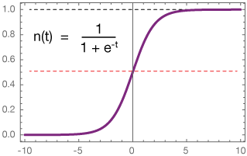
Web application
The idea here is to provide an easy and interactive tool for the hospital sector to be used when patient presents for admission. Input is on left; prediction of mortality is on the right. This can be extended to include more features and predictions indicated in the future state below and deployed to Smartphone
Current State
Prediction of mortality (probability)
Future State
Workforce-load data analysis
Likelihood of admission to ICU (0,1)
Likelihood of intubation
Predicted length of stay for people who die (data limitation)
Current State
Co-morbidities
Age
Sex
Future State
State/County
Other Health Information

Slide 14

Tool Showcase
https://codeforcovid.shinyapps.io/covid19/
https://tinyurl.com/codeforcovid-19

Slide 15
Tool showcase and deep exploration (for analysts and data scientists)
Tool | How to Access
Web Application | https://codeforcovid.shinyapps.io/covid19/ (Developed with R-Studio and hosted on the cloud with Shiny.io)
Data acquisition and transformations (cleansing, categorization, mean normalization) | https://app.lucidchart.com/documents/embeddedchart/de4c3cb3-afe5-45a5-8268-b624617363e6 (Modelled using Lucid Chart)
Data visualization and story | https://public.tableau.com/profile/anisha.parsan#!/vizhome/MexicanCOVIDDataAnalysis/Story2 (Created with Tableau Public)
Iterative model development (scratch book using Python for experimenting). Please note that the final model was implemented in R. Colab work was experimental in nature. | https://colab.research.google.com/drive/1aLBy0KZQsJ5OBKOIhYBdRfYqleDeWeJf?usp=sharing
Notes:
Tool showcase

Slide 16
Process
Detailed information on data preparation steps are available
https://tinyurl.com/code4covidflowchart

Slide 17
Checking uniqueness of key features in dataset
Before transformation for FECHA_DEF:
SEXO | EDAD | EMBARAZO | DIABETES | EPOC | ASMA | INMUSUPR | OTRA_COM | CARDIOVASCULAR | OBESIDAD | RENAL_CRONICA | HIPERTENSION | TABAQUISMO | OTRO_CASO | FECHA_DEF
2 | 121 | 4 | 3 | 3 | 3 | 3 | 3 | 3 | 3 | 3 | 3 | 3 | 3 | 212
After transformation for FECHA_DEF and replacing unknown values (97/98/99):
SEXO | EDAD | EMBARAZO | DIABETES | EPOC | ASMA | INMUSUPR | OTRA_COM | CARDIOVASCULAR | OBESIDAD | RENAL_CRONICA | HIPERTENSION | TABAQUISMO | OTRO_CASO | FECHA_DEF
2 | 119 | 4 | 3 | 3 | 3 | 3 | 3 | 3 | 3 | 3 | 3 | 3 | 3 | 2

Slide 18
Checking missing values in key features
SEXO | EDAD | EMBARAZO | DIABETES | EPOC | ASMA | INMUSUPR | OTRA_COM | CARDIOVASCULAR | OBESIDAD | RENAL_CRONICA | TABAQUISMO | HIPERTENSION | OTRO_CASO | FECHA_DEF
0 | 484 | 792829 | 4840 | 4299 | 4294 | 4593 | 6853 | 4372 | 4276 | 4284 | 4751 | 4497 | 213415 | 0
Key Data Challenges and Adaptation:
EMBARAZO (Pregnancy) and OTRO_CASO (Other Causes) have a huge number of missing values and will not add too much value.
The feature we are predicting has no missing values which will help improve our model.
Age (EDAD) has several missing values and since it’s a key feature we will replace those with mean value

Slide 19
Categorizing age values
trainingdataSubset <- trainingdataSubset %>% mutate(AGEGROUP = case_when(
EDAD >= 111 & EDAD <= 120 ~ 11,
EDAD >= 100 & EDAD <= 110 ~ 11,
EDAD >= 91 & EDAD <= 100 ~ 10,
EDAD >= 81 & EDAD <= 90 ~ 9,
EDAD >= 71 & EDAD <= 80 ~ 8,
EDAD >= 61 & EDAD <= 70 ~ 7,
EDAD >= 51 & EDAD <= 60 ~ 6,
EDAD >= 41 & EDAD <= 50 ~ 5,
EDAD >= 31 & EDAD <= 40 ~ 4,
EDAD >= 21 & EDAD <= 30 ~ 3,
EDAD >= 11 & EDAD <= 20 ~ 2,
EDAD >= 0 & EDAD <= 10 ~ 1)) # end function
Key Data Challenges and Adaptation:
Applying a mean value for missing age values and grouping them we were able improve model accuracy. Here is the list of values after this step –
$AGEGROUP
[1] 3 1 6 8 2 4 5 7 9 11 10

Slide 20
Grouping comorbidities based on the organ
typeofcomDict = {
'DIABETES':'Endocrine'
'ASMA':'Respiratory'
'INMUSUPR': 'Endocrine'
'HIPERTENSION': 'Cardiovascular'
'CARDIO': 'Cardiovascular'
'OBESIDAD': 'Cardiovascular'
'RENAL_CRONICA': 'Endocrine'
'TABAQUISMO':'Respiratory'
'OTRA_COM': 'Other'
'EMARAZO': 'Other'
'OTRO_CASO': 'Other'
}
Key Data Challenges and Adaptation: Having too many individual co-morbidities was causing the model to overfit. Grouping them into bins helped with this issue.

Slide 21
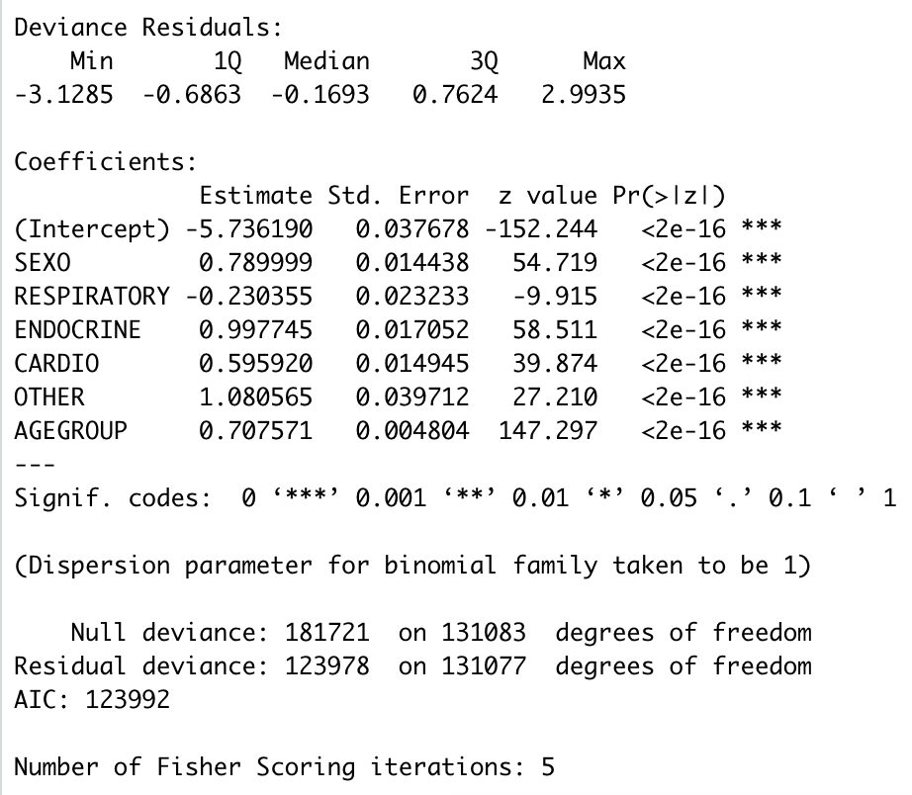
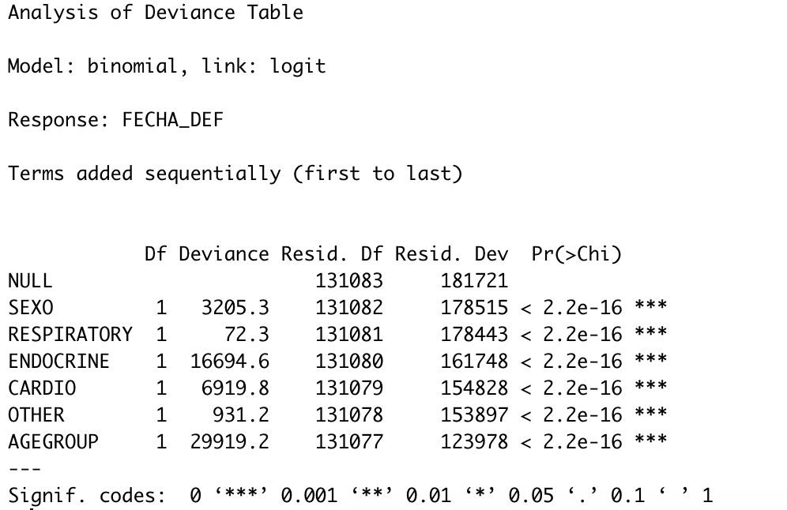
Model Summary
ANOVA Analysis
Pseudo R²

Slide 22
Results
ROC Curve
In the given time frame, the logistic regression model resulted in an accuracy of 78.8%
Planning to test out other state of the art models and apply towards our solution

Slide 23
Next steps;
Opportunities for further investigation
Data limitations in latency and accuracy of reporting mortality as well as counts
Public vs private sector utilization; may have different patterns
Look at end-points, which consisted of admission to an intensive care unit, invasive ventilation or death and compare according to the presence and number of comorbidities.
Length of stay data would be important indicator both regular in-patient and ICU
Developing a Neural Network model eg Artificial NN, Convolutional NN (NLP) of EMRs
  Given presentation of patient with COVID diagnosis, the system is able to assess the level of medical urgency and issue the most appropriate recommendation in terms of best point of care and time to treat.
Implementing hospital bed usage and more resource management information including ventilators and PPE
Workforce load application – enable agile flexing of resource

Slide 24
References Cited
Demographic and Comorbidities Data Description of Population in Mexico with SARS-CoV-2 Infected Patients(COVID19): An Online Tool Analysis. Galván-Tejada et al. - International Journal of Environmental Research and Public Health – 2020
COVID-19 Data Analysis, Part 4: Forecasting Hospital Capacity in Mexico. May 1, 2020. By Jamie Parr
https://dai-global-digital.com/examining-hospital-capacity-in-mexico.html
Comorbidity and its impact on 1590 patients with COVID-19 in China: a nationwide analysis. Eur Respir J. 2020 May; 55(5): 2000547.0
Understanding Mexican health worker COVID-19 deaths. David Agren. World Report: Volume 396, ISSUE 10254, P807, SEPTEMBER 19, 2020

Slide 25

Thank you!
We’ve learned so much through this challenge, and everyone has been helpful in guiding us.
Looking forward to future challenges!

Slide 26
Appendix
English Codebook

Slide 27
English Codebook
The codebook we utilized (provided by the data challenge) is linked below.
https://drive.google.com/drive/folders/1fQJzuR2MDPJx9n9lUVyAbzm2Td8aOXl7

